Slide 1
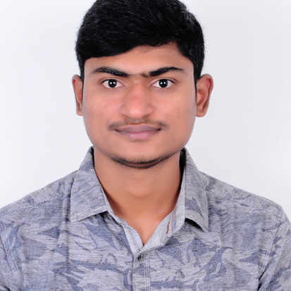



Bayaneni Naresh
Bachelor of Engineering
Information Technology:2017 -2021
Analyst/Software Engineer
Skills
Bangalore
Java 8 /J2EE | Java Basics, OOPS, Generics, Collections, Arrays, Loops, Lambda Exp, Stream API Junit, Mockito, Servlets
Spring core | IOC & Dependency Injection, Autowire
Spring REST | REST controllers, Implementation of GET, POST, PUT & DELETE, Bean Validation & Exception Handling, Testing Services, Controller & Repository layer
Spring Data JPA | Implement DAO layer using spring Data repositories, Transaction Management
Spring Boot Microservices | Spring Boot Starters, annotations, Messaging Service, Swagger API specifications
Spring Cloud | Eureka, Hystrix, Zuul & Config Server
Angular | Components, Services, Modules, Routing, Forms & Validation, Testing using Jasmin & Karma
Database | MongoDB No Sql , My SQL
UI Tech | HTML 5 & CSS 3,JavaScript, ES6 & TypeScript Reusable templates
Tools | Git, Postman, Maven, eclipse,vscode
Add On skills | Communications, Team management. Peer learning
xxxxxxxxxxx@capgemini.com
+91 9618577780
A4
Java Full Stack Developer
Hands on experience in creating microservices with Spring Boot, Spring Security, Spring Cloud API Gateway, Eureka server.
Hands on experience in creating Single page Web Application in Angular latest versions.
Hands on experience in connecting mongoDB with spring boot and Angular
Experience in creating documentation with Java docs and swagger and in unit testing using Junit, Mockito
Development experience in creating docker images
In-depth understanding of deploying spring boot applications in AWS Cloud environment
Implementation of RabbitMQ
Flight Booking System Application
Completed end to end case study of Flight Booking System Application with Spring Boot, Angular and MongoDB along with JWT authentication, Swagger and implemented testing using Mockito.
Completed ”Python for Data Science and Artificial Intelligence “ course at Coursera.
S2S Translator using CNN
completed end to end project in final semester using python and Machine Learning.
Check out my work on GitHub & Video Profile

